Slide 1


Onion architecture
Amit Naik
Sponsored by

Slide 2

Onion architecture with asp.net core

Slide 3
Agenda
Difference between Desgin pattern, Architecture Pattern & Architecture Style
Database centric architecture vs. Domain-centric architecture
What is Onion Architecture
IOC, DI
Simple Demo project for OA
Real time project on OA
Q & A

Slide 4
Session will cover some Interview question
What are design pattern you have used in your project? Can you explain few with example?
What is difference between Design pattern and Architecture pattern
Project demo
How you document your project
Best practice for code quality
Clean code, release/tags, versioning, code review

Slide 5
What is onion architecture
Architecture pattern
Composed of Domain centric architecture
Based on IOC

Slide 6
Difference between Design pattern, Architecture Pattern & Architecture Style
In simple words
What you want
How you implement
How you solve problem

Slide 7
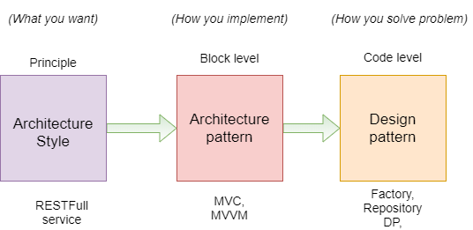

Slide 8
An Architectural Style is the application design at the highest level of abstraction;
An Architectural Pattern is a way to implement an Architectural Style;
A Design Pattern is a way to solve a localised problem.

Slide 9
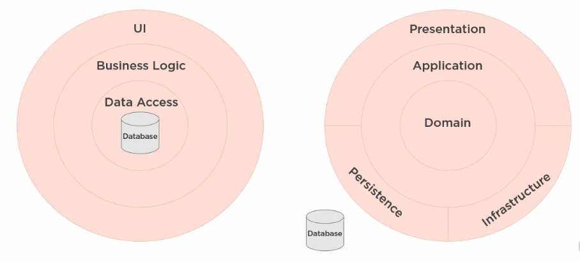
DATABASE-CENTRIC VS. Domain-centric architecture

Slide 10
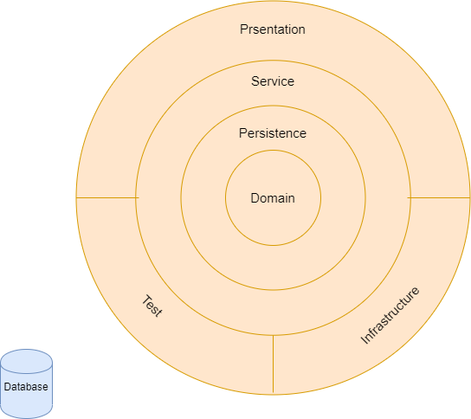
Onion architecture

Slide 11
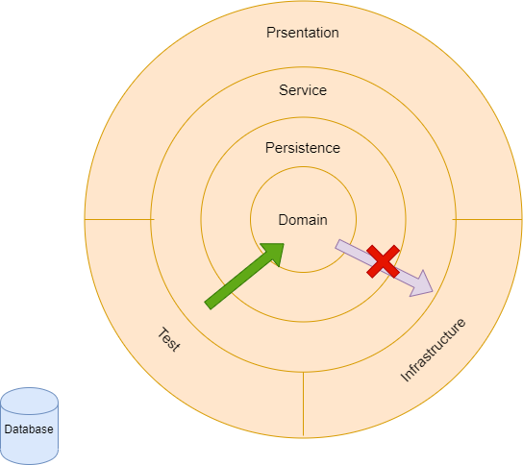

Slide 12
Onion, CLEAN & Hexagonal arch.
https://jeffreypalermo.com/2008/07/the-onion-architecture-part-1/
https://blog.cleancoder.com/uncle-bob/2012/08/13/the-clean-architecture.html
https://alistair.cockburn.us/hexagonal+architecture

Slide 13
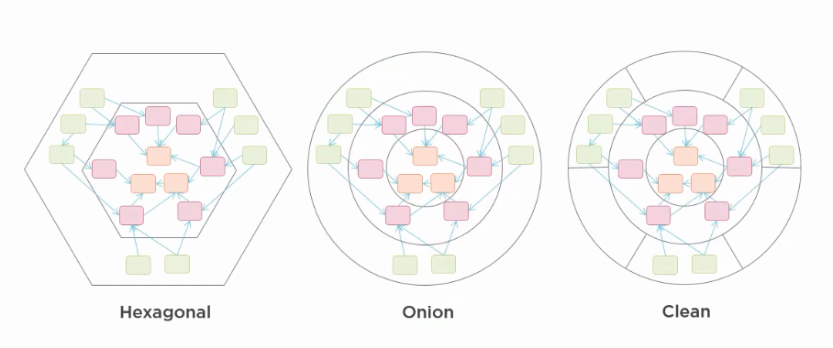
It’s all same thing
https://blog.ploeh.dk/2013/12/03/layers-onions-ports-adapters-its-all-the-same/

Slide 14
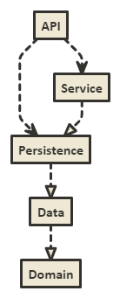
Class diagram

Slide 15
Project demo
Project is available in Microsoft marketplace and nuget.org
https://marketplace.visualstudio.com/items?itemName=AmitNaik.OnionArchitecture
https://www.nuget.org/packages/OnionArchitecture.API/

Slide 16
Thanks
Shivaprasad Koirala
Sukesh Marla
Pradeep Shet
Dhiraj Poojary

Slide 18
Thank you

